Slide 1
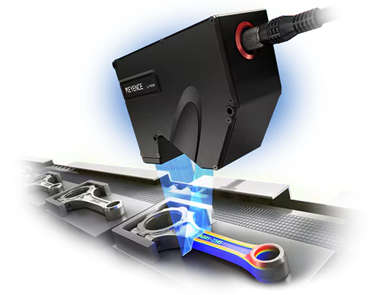
LJ - X8400 Laser Scanner
Muhammad Zeeshan Yousaf
Group Members
Muhammad Zeeshan Yousaf (Slide 1-10)
Kasmin Talukdar (Slide 11-15)
Ashwini Joshi (Slide 16-20)
Utkarsh Mishra (Slide 17-26)
Muhammad Hasan Khan (Slide 27-36)
Amritha Anitha Vasanthan (Slide 37-45)
Measurement Application

Slide 2
Contents
Muhammad Zeeshan Yousaf
Project Requirements
Mount for Sensor
Structure of Layout
Details of Sensor and Controller
Data Flow of App
Details of Back End
Details of Front End
Live Data Page
2D Capture Data Page
2D Compare Data Page
3D Data Page

Slide 3
Project Requirements
Muhammad Zeeshan Yousaf
Development of Web based or native app.
Acquisition of live Data from the sensor.
Measurement of 2d data
Comparison of 2d data
3D construction of object using scans from several time stamps
Creating a mount for sensor to mount sensor on a table or a robot

Slide 4
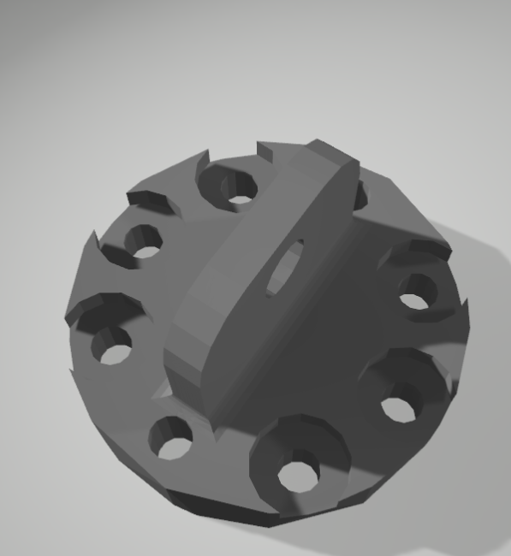
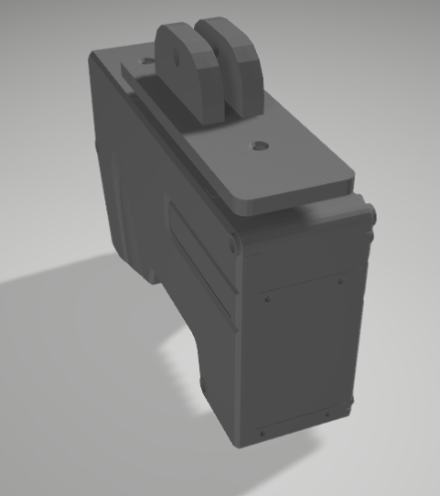
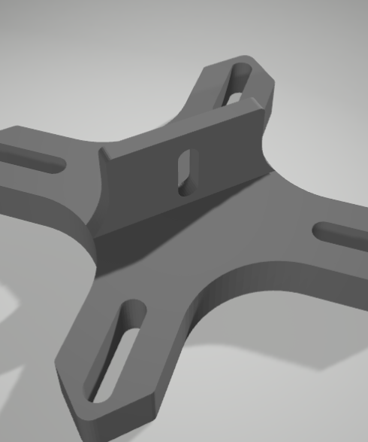
Mount For Sensor
Muhammad Zeeshan Yousaf

Slide 5
Structure and layout of the App
Muhammad Zeeshan Yousaf
Sensor/
Controller
Back End
FastAPI (Python)
ctypes (DLL/.so)
Keyence LJ-X8400 SDK – sensor communication
Front End
React.js
@react-three/fiber & @react-three/drei visualizationChart.js
CSS – for styling
WebSocket / Fetch API
REST API
Ethernet
Web Socket

Slide 6
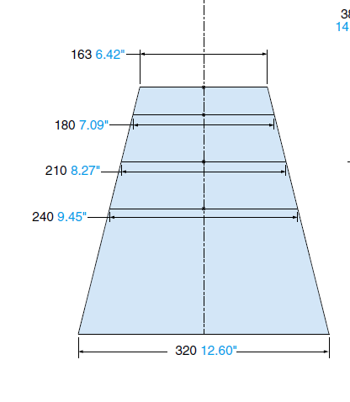
About L J-X8400
Muhammad Zeeshan Yousaf
Laser
Blue semiconductor laser having 10 mW output.
Data
3,200 data points per profile.
Range
In X- direction up to 240 mm ( at 0 Level)
In Z direction from 380 mm
Interface
Ethernet TCP
USB
Measurement Principle
Laser Triangulation

Slide 7
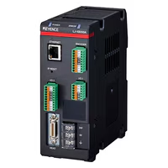
Controller Functionalities
Muhammad Zeeshan Yousaf
Ip Setting
Ethernet communication
Encoder and input controls
Sample rate setting
Dead zone Interpolation
Filter Setting
Laser Brightness and Intensity
Tilt Correction

Slide 8

Data Flow in App
Muhammad Zeeshan Yousaf
Data stored on local storage
Sensor
Back END
Front END
Live Data
CSV
Data From local storage
Data Packet
Height Points
Plot x axis / z axis
Compare Data
2D Data
3D Data

Slide 9
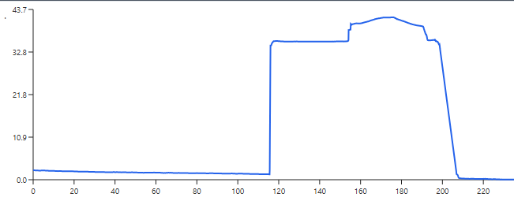
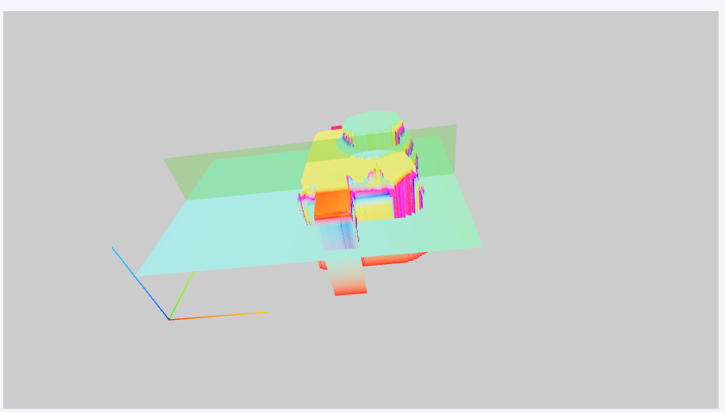
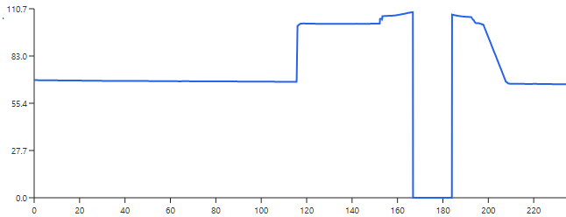
Data Cleaning / Dead zone Removal
Muhammad Zeeshan Yousaf

Slide 10
Detailed Explanation
Muhammad Zeeshan Yousaf
Back End
Front End
2D Data + Compare Data
3D Data

Slide 11
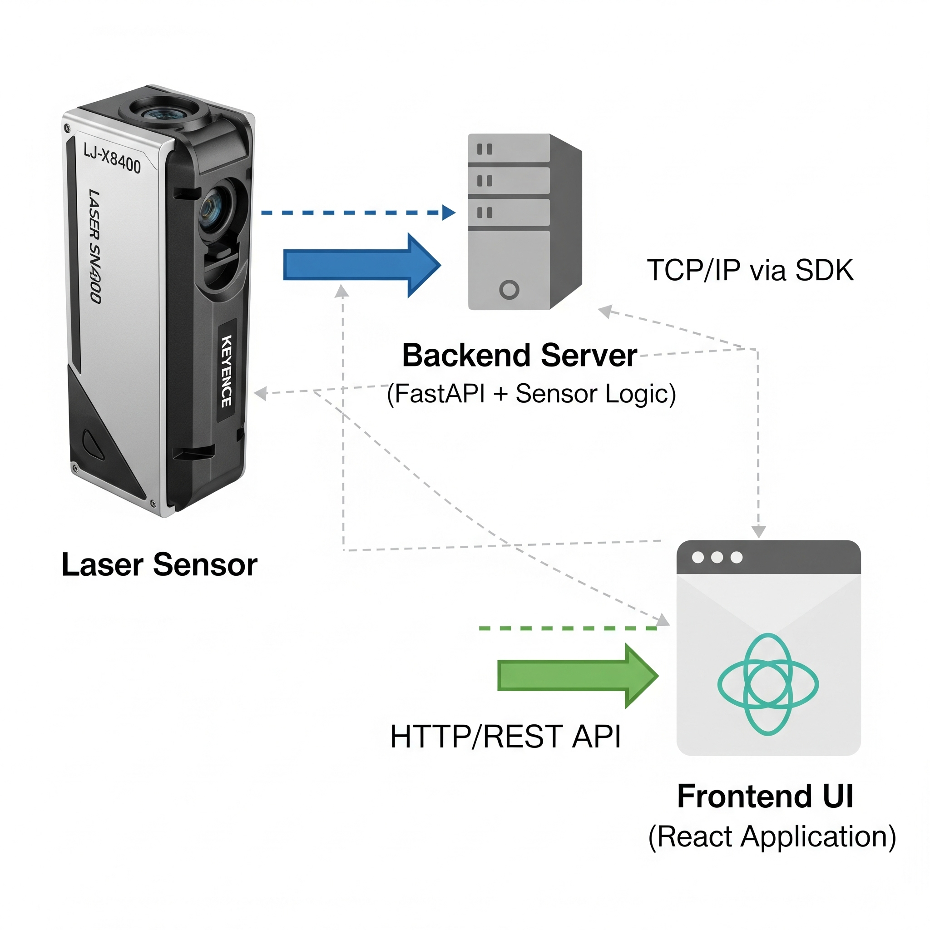
What is a Server & Why We Need It Here
Kasmin Talukdar
A server is an application that listens for requests from clients (frontend/UI) and sends back responses (data or actions).
In our application, the backend server:
• Acts as a bridge between the React UI and the Keyence LJ-X8400 sensor
• Handles requests like connect, disconnect, get profile
• Ensures controlled, secure communication with the sensor hardware
Without a server:
• The frontend would have to connect to the sensor directly, which is not feasible due to protocol complexity and security constraints.

Slide 12
Why We Use FastAPI (vs Django / Node.js)
Kasmin Talukdar
Fast API Advantages:
• High performance
• Easy to write clean, modern Python code
• Built-in async support for non-blocking calls to the sensor
Why not Django:
• Django is heavier, better for full web apps with templating, DB, we only need a fast API layer
Why not Node.js:
• Would require rewriting all sensor handling logic in JS
• We already use Python for the Keyence SDK wrapper and data processing

Slide 13
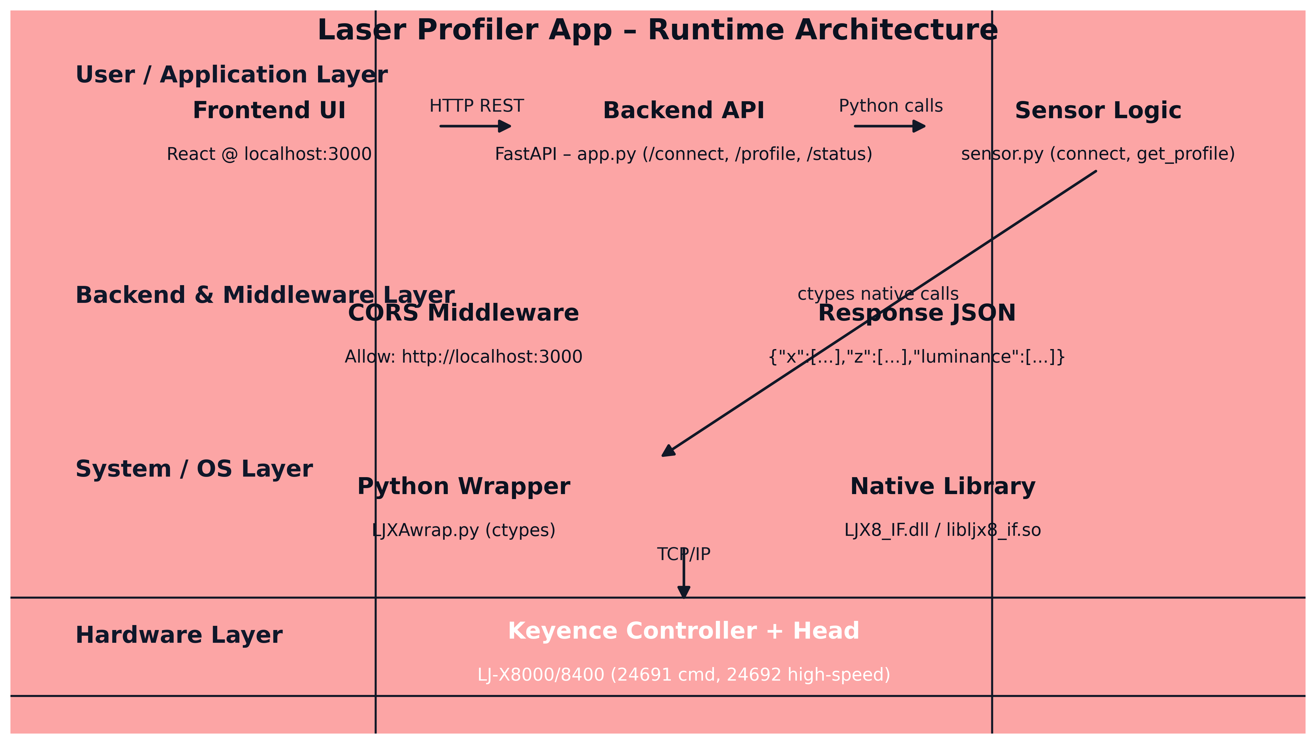
High-Level Backend Architecture
Kasmin Talukdar
Frontend (React) → HTTP API calls → Backend (FastAPI) → Sensor Logic (sensor.py) → Wrapper (LJXAwrap.py) → Native C library → Controller → Sensor head
Each layer has a specific job — separation makes it easier to debug, maintain, and extend

Slide 14
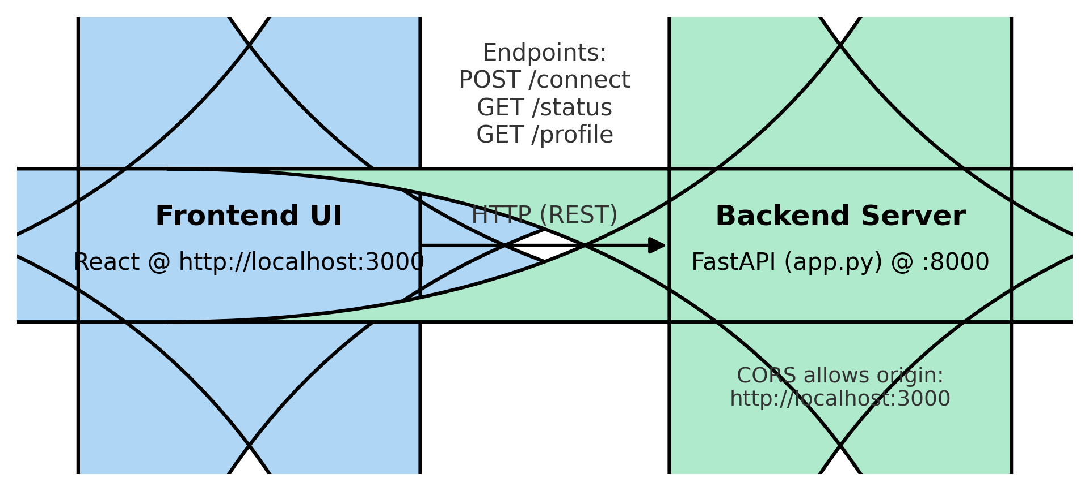
Frontend to Backend Communication
Kasmin Talukdar
Frontend calls endpoints: /connect, /status, /profile
CORS middleware allows cross-origin requests from http://localhost:3000
Backend parses request, triggers sensor.py functions, returns JSON

Slide 15
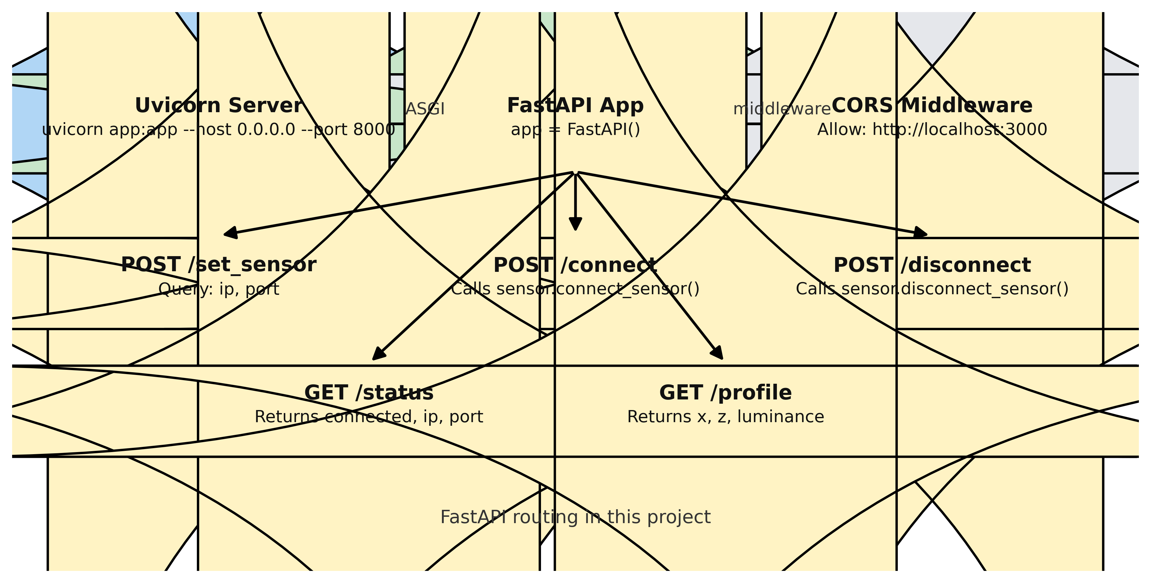
FastAPI Routing
Kasmin Talukdar
Routes:
• POST /set_sensor – store IP & port in state
• POST /connect – connect to sensor
• POST /disconnect – disconnect
• GET /status – connection state
• GET /profile – latest profile data
GET = retrieve without changing state
POST = actions that change backend state

Slide 16
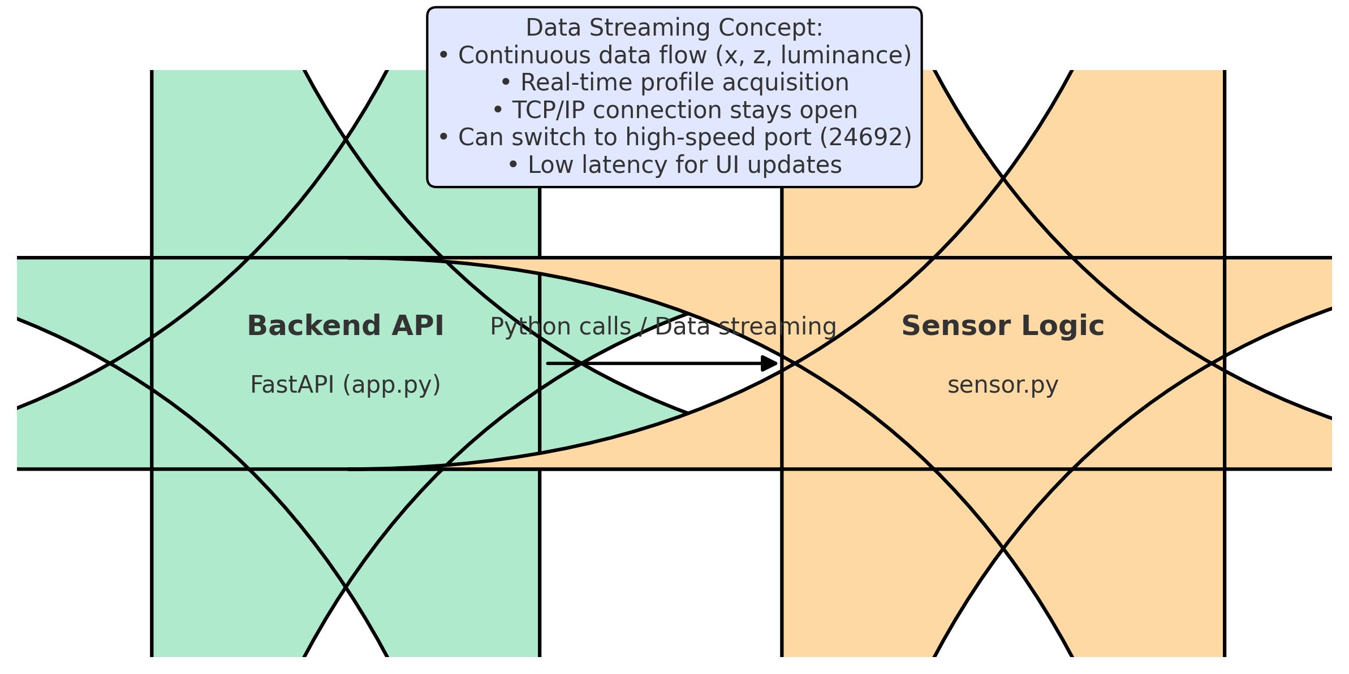
Backend to Sensor Layer
Ashwini Joshi
Controller = The hardware control unit between PC and sensor head
LJX8IF_EthernetOpen opens TCP/IP session to controller
Backend sends/receives binary data via Keyence SDK functions
CORS not involved here (only UI ↔ backend)

Slide 17
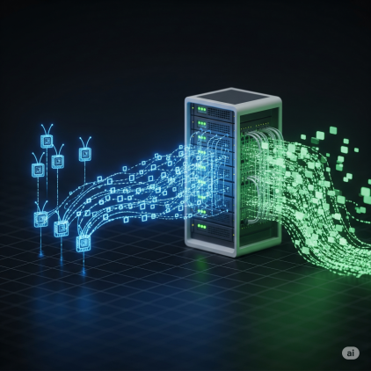
Data Streaming Concept
Ashwini Joshi
Maintain open connection → continuously read sensor profiles without reconnecting every time
Backend streams latest data upon frontend request
Benefits: low latency, real-time updates

Slide 18
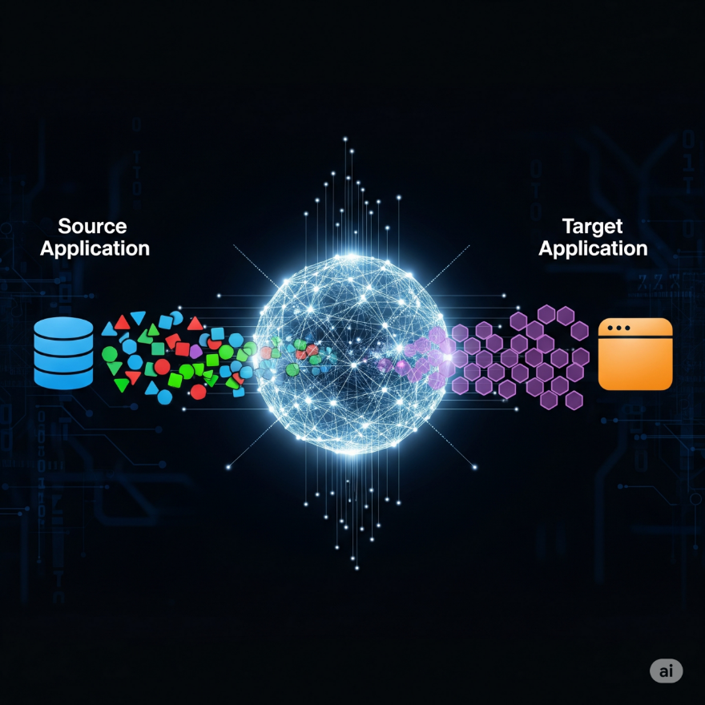
Middleware & Python Wrapper
Ashwini Joshi
Middleware & Python Wrapper
Middleware: CORS layer in FastAPI — lets browser frontend call backend despite different origin
Python wrapper: LJXAwrap.py bridges Python and the native LJX8_IF.dll / .so library
Without wrapper: Python can’t directly call C API functions from Keyence SDK

Slide 19
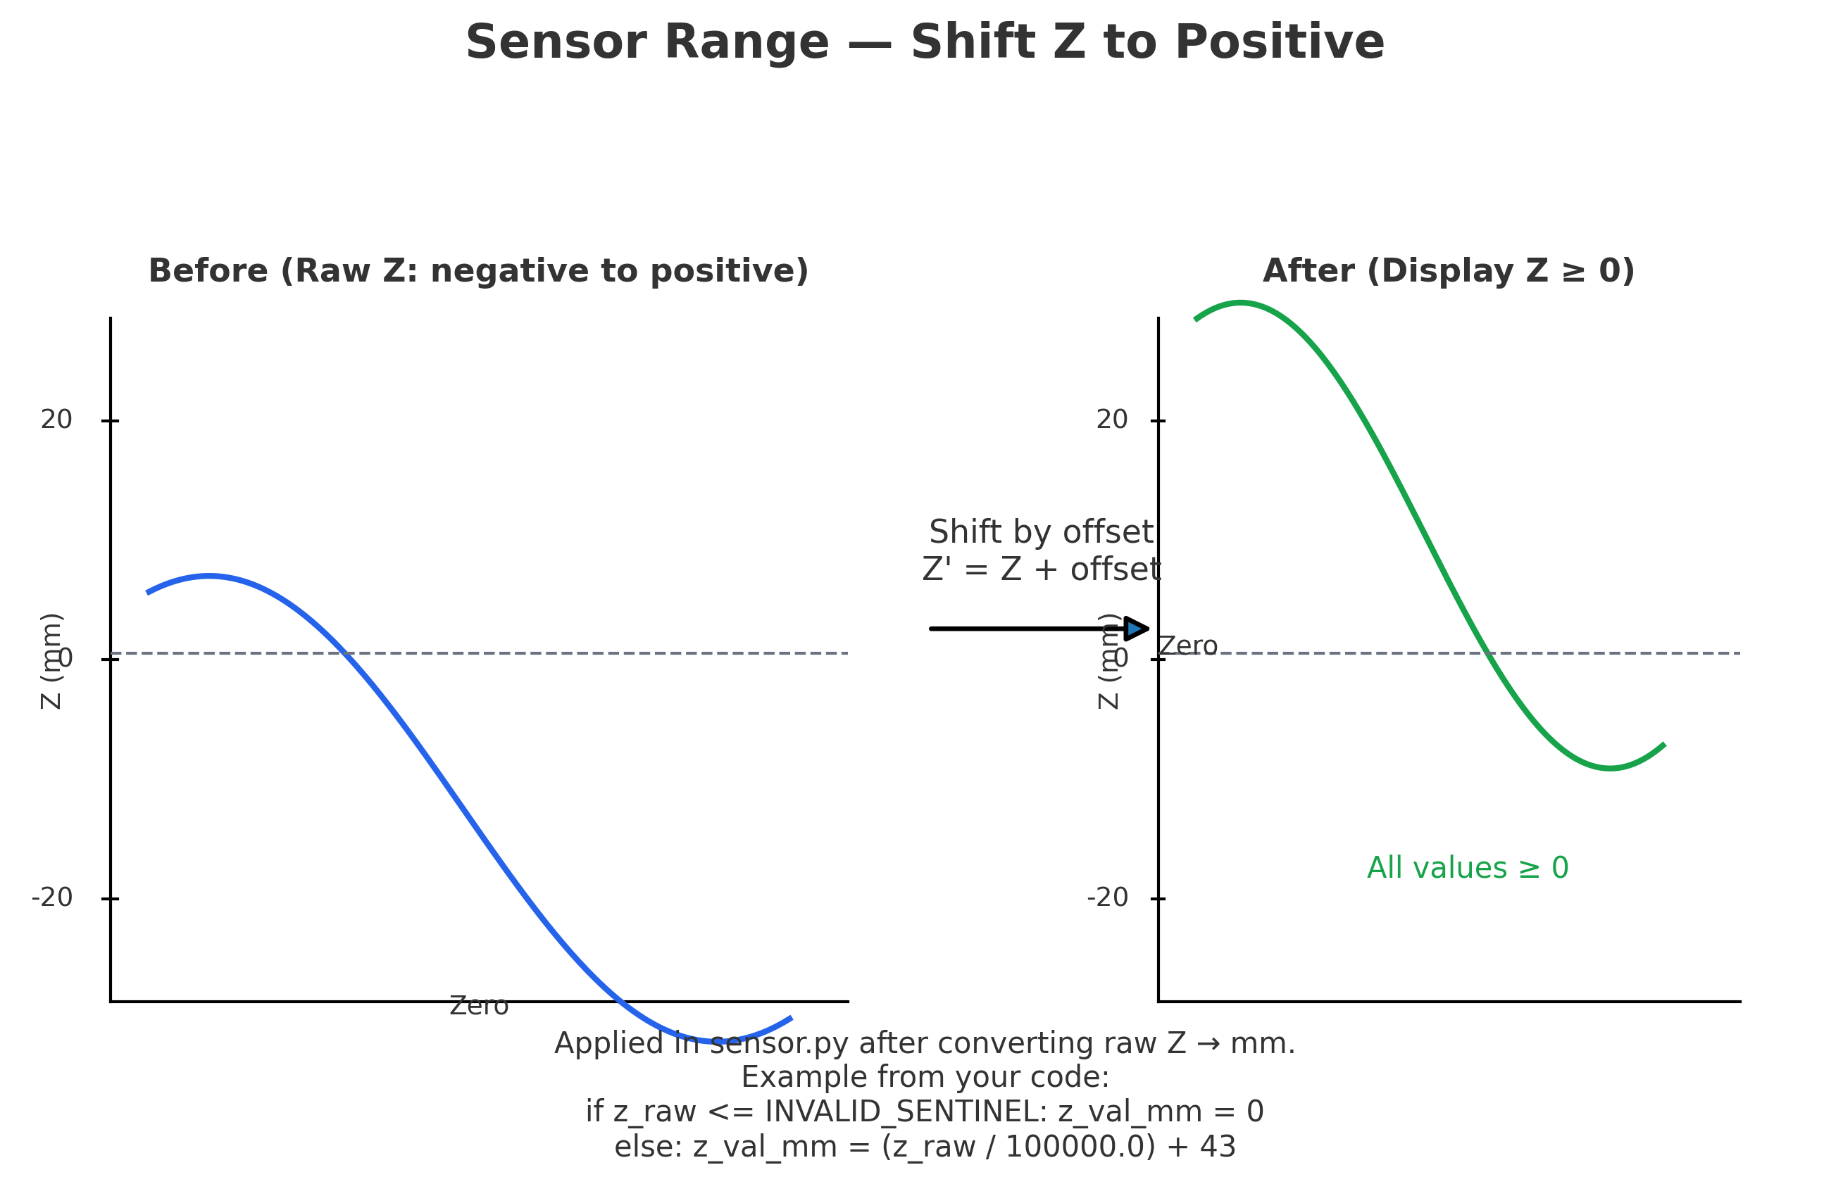
Sensor Range Handling (Why)
Ashwini Joshi
Raw Z from Keyence can be negative depending on calibration/reference
We shift Z to always be ≥ 0 for clear visualization
Code adds +43 mm offset after conversion from raw units

Slide 20
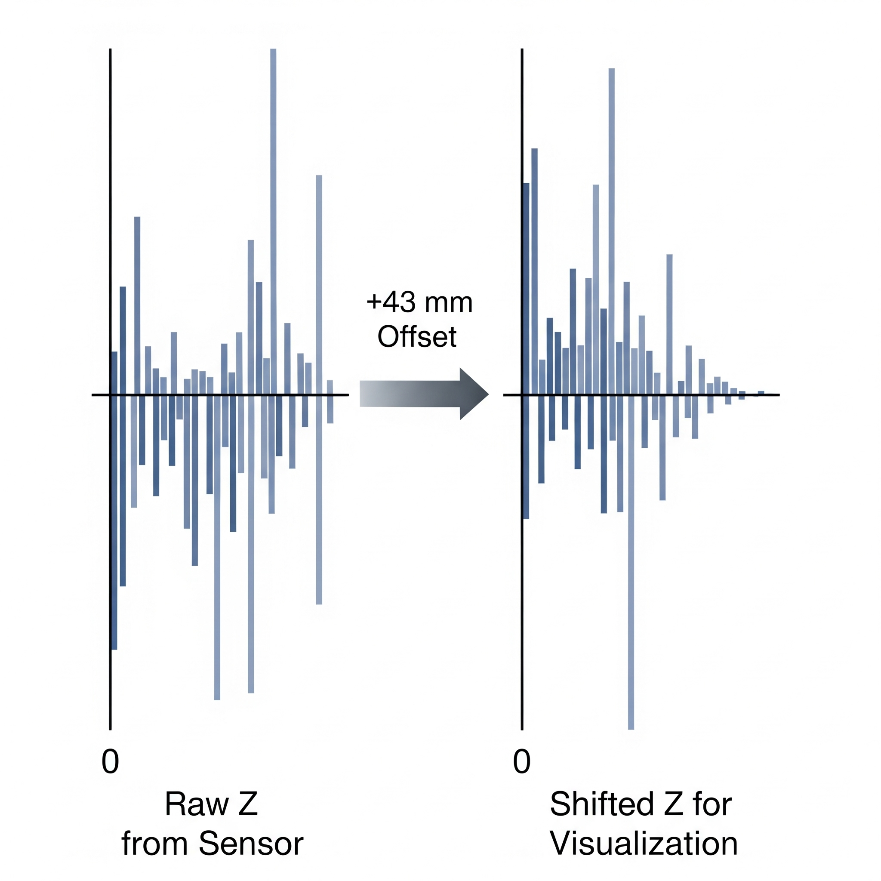
Sensor Range Handling
Ashwini Joshi
Strategies:
• Fixed offset (+43 mm) — simple and stable
• Auto-baseline — shift so min(Z) is zero each time
• Use controller’s ZUnit for accurate scaling

Slide 21
Frontend Architecture Overview
Utkarsh Mishra
React.js + TailwindCSS for modern UI development
Component-based architecture with reusable modules
React Router for navigation between different data views
Context API for global state management
Real-time data visualization with SVG charts

Slide 22
Application Structure & Routing
Utkarsh Mishra
4 main pages: Live Data, 3D Data, Captured Data, Compare Data
Sidebar navigation with collapsible design
Header with application title and controls
Help center modal for user guidance
Responsive design for different screen sizes

Slide 23
Live Data Page & Real-time Capture
Utkarsh Mishra
Real-time laser profile visualization
Start/Stop/Pause capture controls
Settings modal for sensor configuration
Data export to CSV format
Zoom and pan controls for detailed analysis

Slide 24
Data Flow Process
Utkarsh Mishra
User opens Live Data page
Frontend checks sensor status via /status endpoint
User configures sensor settings and clicks Connect
Backend establishes connection to physical sensor
User clicks "Start Capture" to begin data collection
Frontend polls /profile endpoint every 200ms
Real-time data is visualized as SVG line charts
User clicks "Stop Capture" to end collection
Data is automatically exported as CSV file
Captured data can be viewed in other pages for analysis

Slide 25
Data Management & Context System
Utkarsh Mishra
ScanDataContext for global state management
Persistent storage using localStorage
Multiple data collections: live, captured, 3D, compare
Measurement tools with distance calculations
Data sharing between components

Slide 26
Backend Integration & Data Flow
Utkarsh Mishra
FastAPI backend with CORS enabled for localhost:3000
RESTful API endpoints: /status, /connect, /disconnect, /profile, /set_sensor
Real-time polling mechanism for live data
Error handling and connection status indicators
Sensor control through Python wrapper

Slide 27
2D Capture Data Page
Muhammad Hasan Khan
View one stored scan
Load CSV → show “Scan i / N”
Slider jumps between scans
Measure On toggles rulers/point-pick
Wheel = zoom, drag = pan

Slide 28
2D Capture Page flow
Muhammad Hasan Khan
Load CSV
Move slider to a scan
Turn Measure On
Drag A/B markers
Read ΔX, ΔZ, straight distance, angle

Slide 29
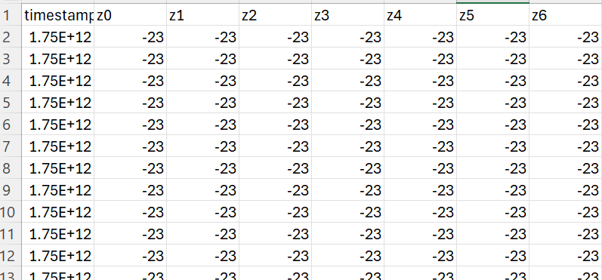
CSV loading
Muhammad Hasan Khan
User selects CSV, read as plain text
Split lines; each row is one scan
Rebuild data if X missing
Update UI: “Scan 1/N”, enable slider and measuring
Compare page repeats this for Left and Right

Slide 30
Measuring (what it computes)
Muhammad Hasan Khan
Z@A, Z@B via linear interpolation
ΔX = |xB − xA|
ΔZ = |zB − zA|
Straight distance
Angle
Path distance
GO TO APPLICATION

Slide 31
Compare 2D Data
Muhammad Hasan Khan
Two panels: Left and Right
Each has its own Load, Measure, Slider
Use to compare shape/values side-by-side

Slide 32
Compare Data Page flow
Muhammad Hasan Khan
Compare page: load left CSV and right CSV
Compare page: enable Lock Compare
Compare page: scrub slider to view matched scans
Compare page: disable Lock to move independently
Compare page: use Point Measure to compare a feature

Slide 33
Measuring (what it computes)
Muhammad Hasan Khan
Z@A, Z@B via linear interpolation
ΔX = |xB − xA|
ΔZ = |zB − zA|
Straight distance
Angle
Path distance

Slide 34
Lock Compare (how it works)
Muhammad Hasan Khan
locked = one slider drives both
On left change → right Current = leftCurrent
Unlock to move independently
GO TO APPLICATION

Slide 35
Saving/ using CSV
Muhammad Hasan Khan
Live capture collects scans in memory
Save builds a CSV: header, then one row per scan
Each row = comma-separated sample values (x optional, z required)
File downloads as .csv for reuse
2D and Compare pages load this same format
Compare loads one file per side; Lock Compare works
best when scan counts match

Slide 36
Components Main Functionalities
Muhammad Hasan Khan
Profile Viewer
Renders the profile curve
handles zoom, pan, rulers, and point-pick
Scan Data Context
Holds left and right scans for Compare
Implements Lock Compare by syncing right and left when locked is true, and scans for 2D page

Slide 37
3D Layout
Amritha Anitha Vasanthan
3D Stitching- Viewer3D
The 3D surface is made by stacking 2D profile next to each other.
Triangles are built between adjacent height points to form a surface.
3D surface created using mesh principle.

Slide 38
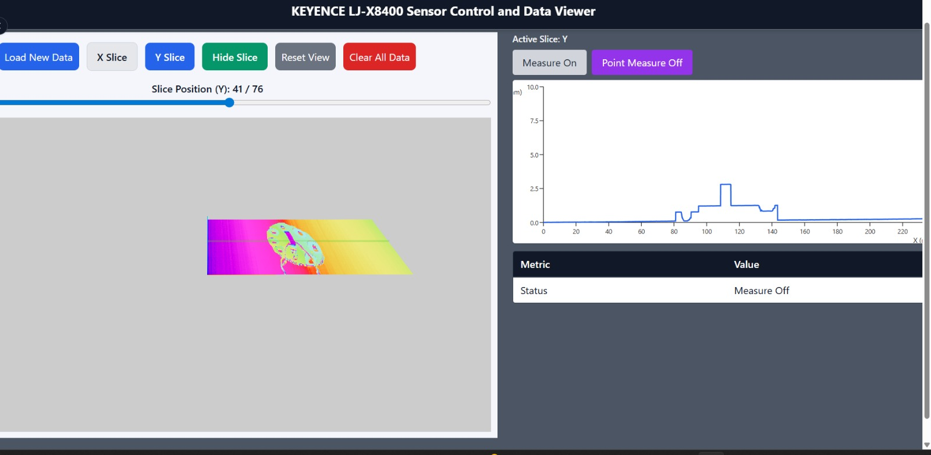
3D Layout
Amritha Anitha Vasanthan
3D page (to app)

Slide 39
3D viewer- buttons
Amritha Anitha Vasanthan
Left side- 3D surface view, right side-2D slice and measurement panel.
Load new data button- Loads new scanned surface data, CSV file.
X/Y Slice- To chose slice direction.
Show hide slice- Toggle slice panel visibility.
Slice slider- To move plane across the object to select profile.
Reset
Zoom in/out
clear

Slide 40
Extract slice from 3D
Amritha Anitha Vasanthan
Click on the ‘show slice’
Slider to desired location
Selected profile automatically appears in the 2D viewer.

Slide 41
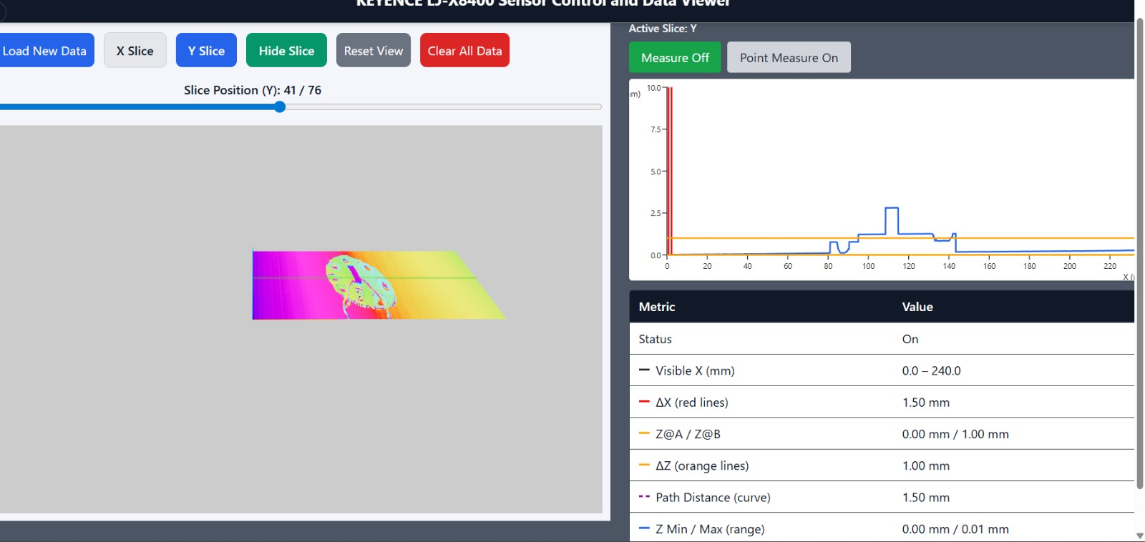
2D slice and measurement panel
Amritha Anitha Vasanthan

Slide 42
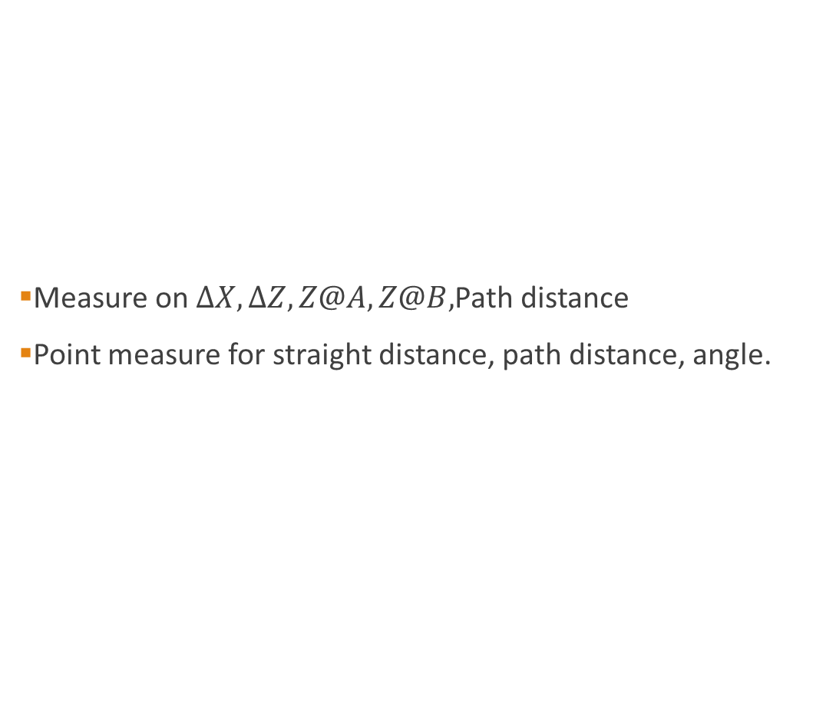
Measurement modes
Amritha Anitha Vasanthan
Measure on $∆X,∆Z,Z@A,Z@B,$Path distance
Point measure for straight distance, path distance, angle.

Slide 43
Applications
Amritha Anitha Vasanthan
Industrial Automation
Smart packaging
Quality control
Industrial inspection and maintenance
Integration on robots

Slide 44
Future Work
Amritha Anitha Vasanthan
Automated conveyor system for Consistent Scanning.
Adaptive Filtering based on Measurement Parameters.
AI/ML based Damage Classification.
AI Assisted Correction and Measurements.

Slide 45
Amritha Anitha Vasanthan
THANK YOU
QUESTION?

